Slide 1
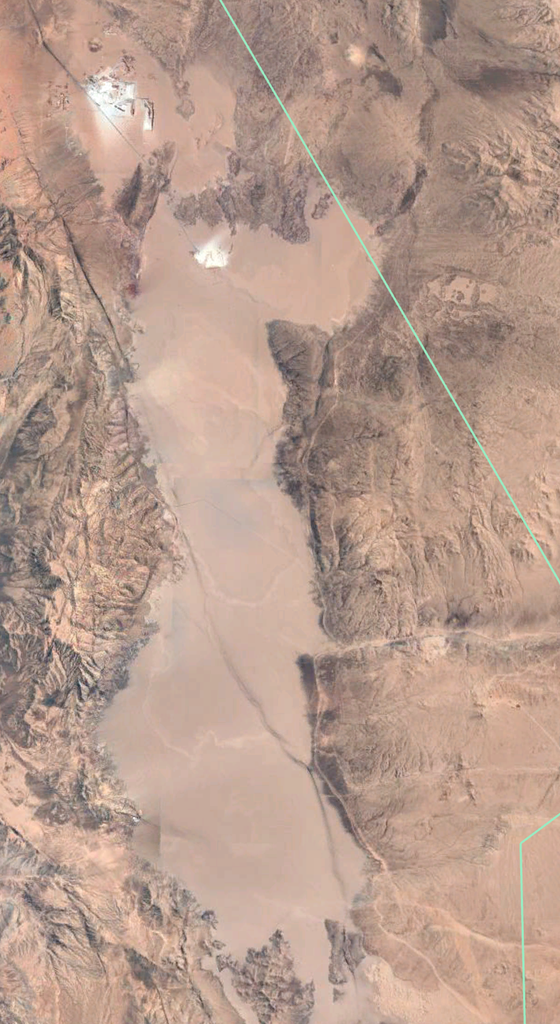
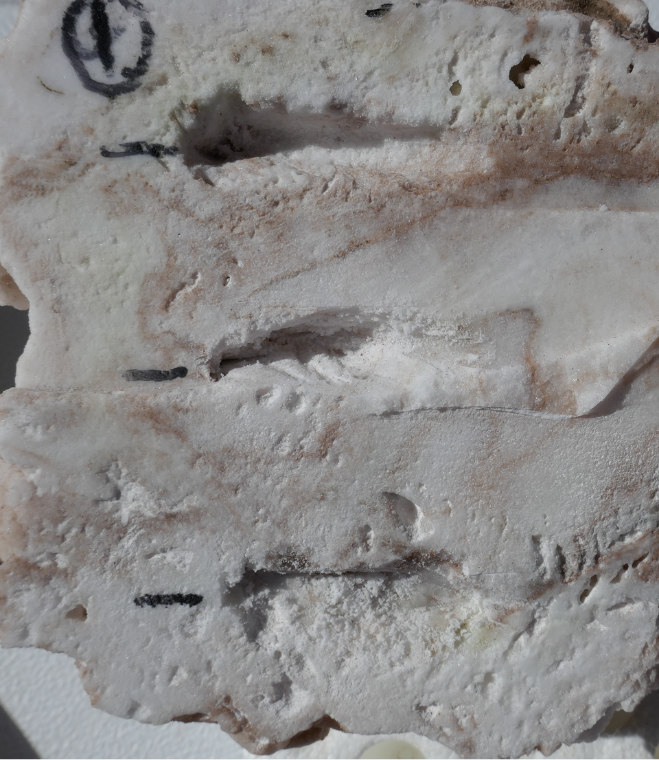
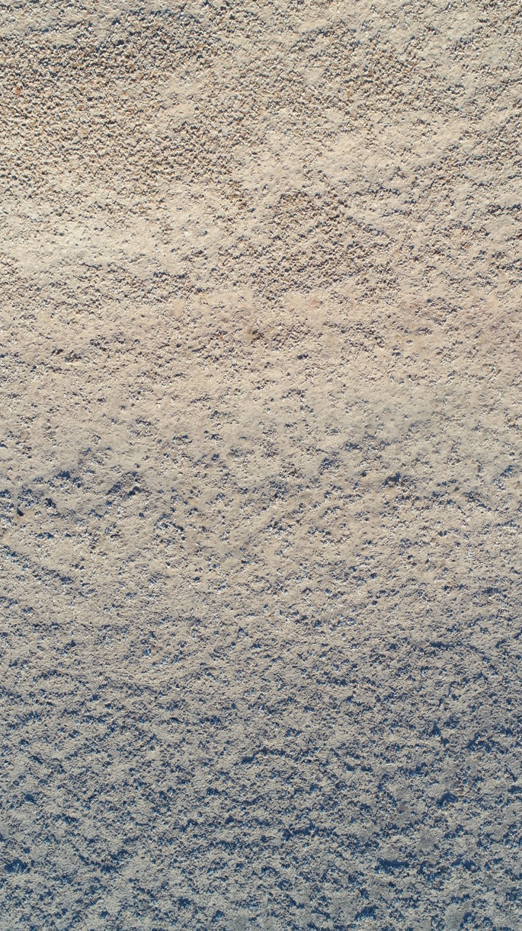
A.
B.
C.
Top
SG1
SG1- Top
Middle
SG2
SG1-Bottom
Bottom
5km
20m
3cm
Notes:
Figure: (A) Google Earth view of the entire Salar Grande, highlighting the sampling regions named SG1 and SG2. (B) A top-down drone image of the slope of the hill at SG1, showing the sampling areas at the top and bottom of the hill. (C) A cross-section of a model halite nodule, showing the locations of samples taken from the top, middle and bottom of the nodule in respect to the nodule’s original orientation.

Slide 2
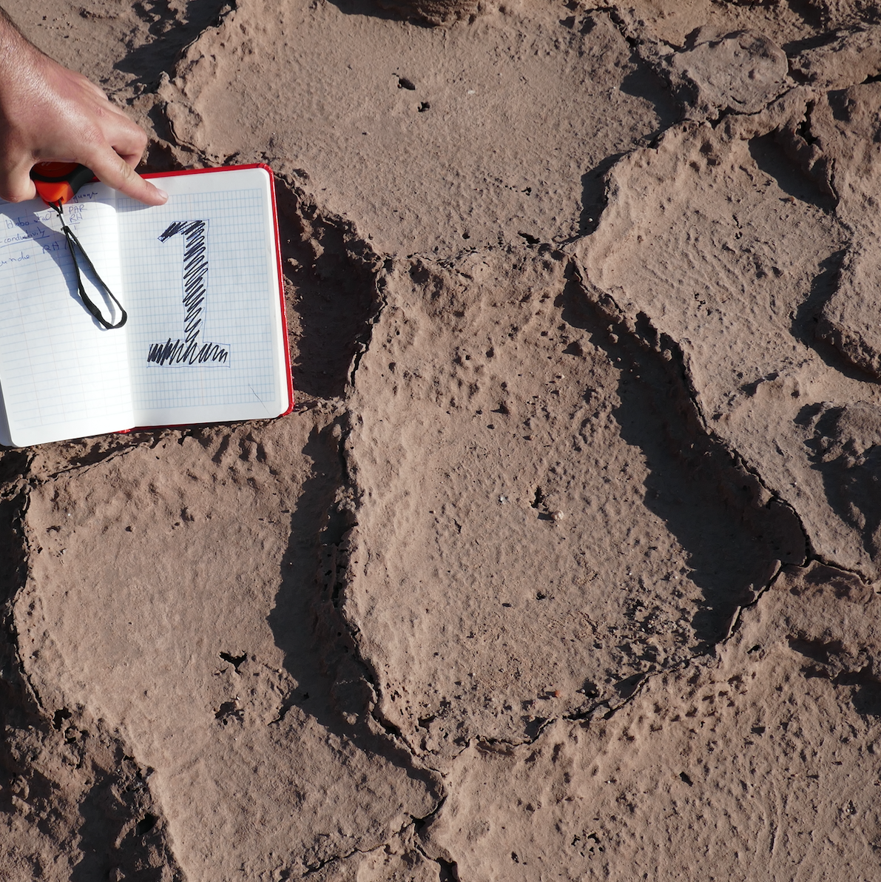
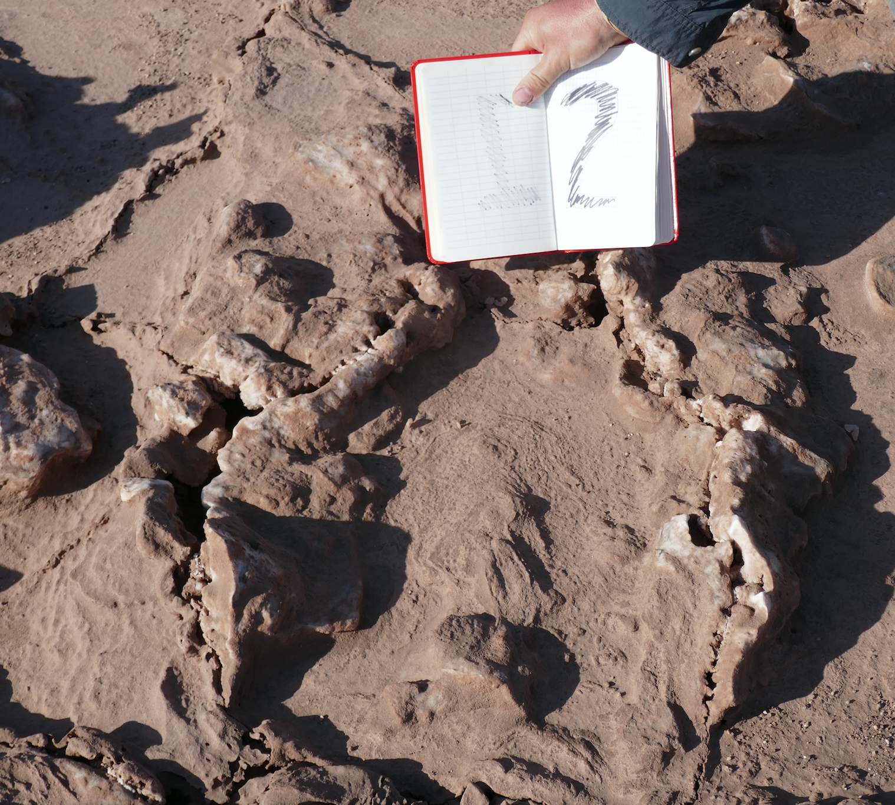
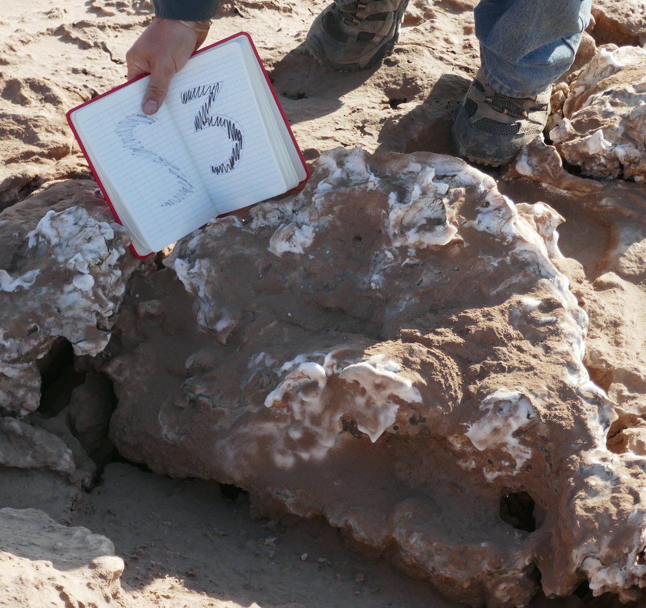
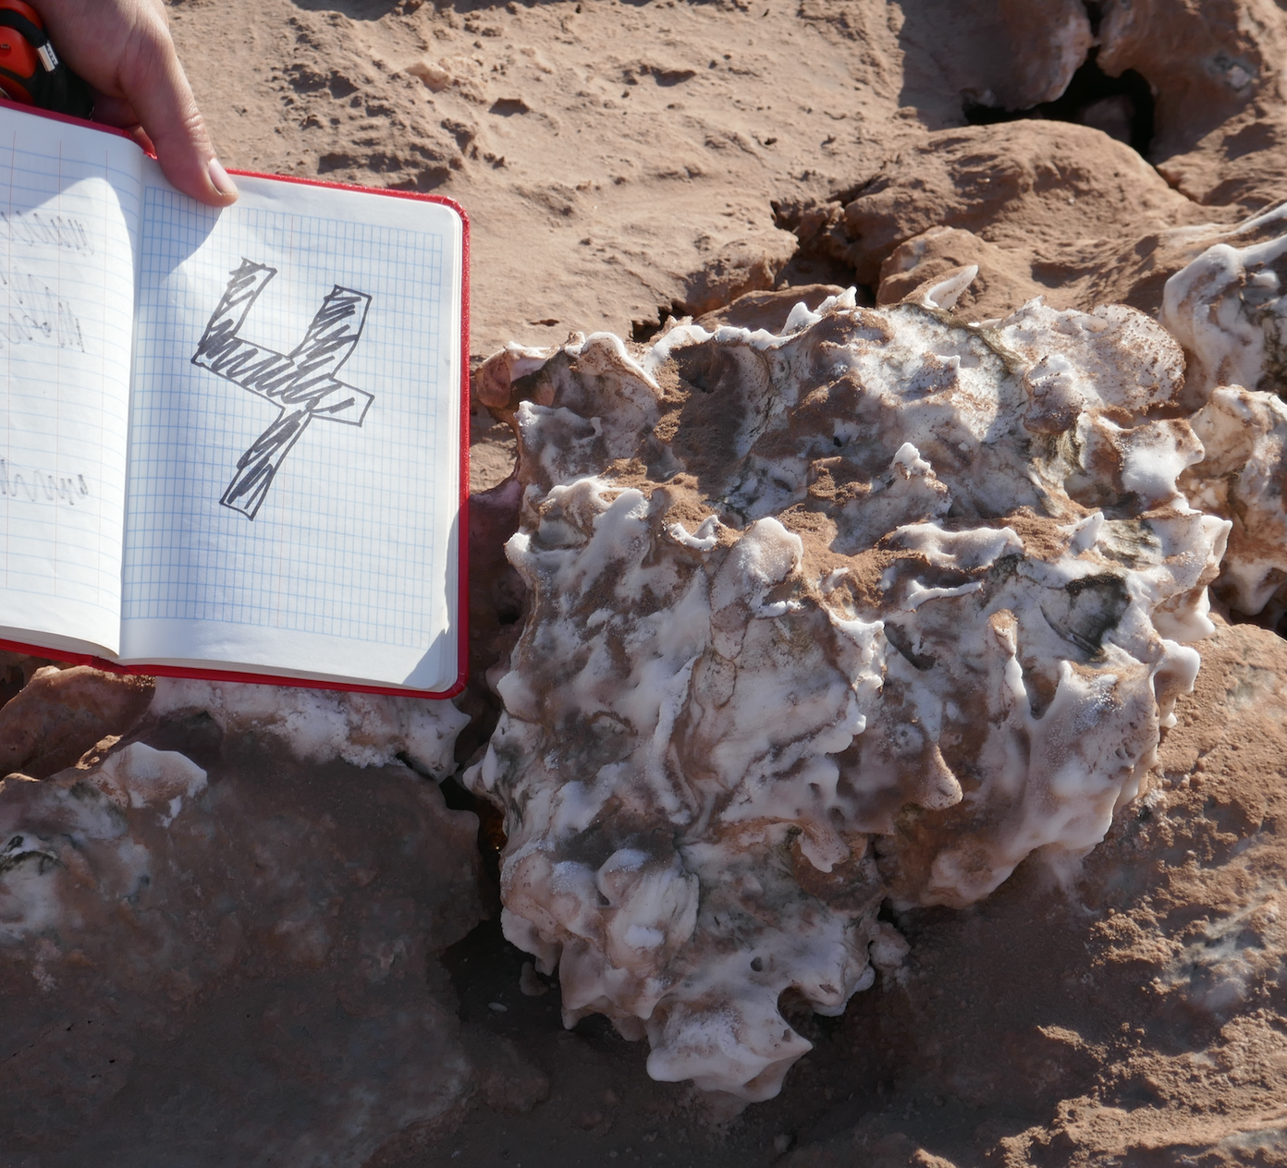
A.
B.
C.
D.

